Slide 1


Tianyuan Zhu
July 24, 2022

Slide 2

Outline
Executive Summary
Introduction
Methodology
Results
Conclusion
Appendix

Slide 3
Executive Summary
Summary of methodologies
Data collection: SpaceX API and web scraping
Data wrangling: Deal with missing values, calculate variables for analysis
Data visualization: different charts - scatter, bar, line. interactive visual analytics using Folium and Plotly Dash
Prediction models investigated: K Nearest Neighbors, Decision Tree, SVM, Logistic Regression
Summary of all results
Location of launch sites are proximity to Equator line, coast and railway but far way from city.
Whether the landing is successful or not are associated with launch site, payload mass, orbit type, boost version, and time.
Launch site KSC LC-39A has the highest success rate which is around 77%.
The launch success rate increases from 2013 to 2020.
The decision tree has the highest classification accuracy which is about 94.4%. Thus, it should be used as the classification method for landing prediction.

Slide 4
Introduction
Project background and context
Companies are making space travel affordable for everyone.
SpaceX Falcon 9 rocket: Costs 62 million dollars. Over100 million dollars less than the cost of other providers since SpaceX can reuse the first stage if it lands successfully.
Our company (SpaceY) would like to compete with SpaceX.
Problems you want to find answers
Whether SpaceX will reuse the first stage
Cost of each launch for SpaceX

Slide 5

Section 1

Slide 6
Methodology
Executive Summary
Data collection methodology:
Describe how data was collected
Perform data wrangling
Describe how data was processed
Perform exploratory data analysis (EDA) using visualization and SQL
Perform interactive visual analytics using Folium and Plotly Dash
Perform predictive analysis using classification models
How to build, tune, evaluate classification models

Slide 7
Data Collection – SpaceX API
The SpaceX launch data is collected using an API called SpaceX REST API. The process is shown in the following flowchart:
Target a specific endpoint of the API
Perform a get request to obtain data
View result by calling the .json() method
Convert JSON objects to dataframe using json_normalize function
GitHub URL of the completed SpaceX API calls notebook:
https://github.com/bunny-tz/IBM_DS_Capstone/blob/b96d815f1fae2106d8b6897d6209b9eb403dce63/w1_jupyter-labs-spacex-data-collection-api.ipynb

Slide 8
Data Collection - Scraping
Web scrap Falcon 9 launch records with BeautifulSoup. The process is shown in the following flowchart:
Request the Falcon9 Launch HTML page with HTTP GET method
Create a data frame by parsing the launch HTML tables
Collect all relevant column names from the HTML table header
GitHub URL of the completed web scraping notebook:
https://github.com/bunny-tz/IBM_DS_Capstone/blob/b96d815f1fae2106d8b6897d6209b9eb403dce63/w1_jupyter-labs-webscraping.ipynb

Slide 9
Data Wrangling
The data wrangling mainly includes two parts: dealing with missing values and calculating variables that are useful for data analysis. The process is shown in the following flowchart:
Find missing values
Replace missing values with the mean calculated
Calculate the number of launches on each site
Calculate the number and occurrence of each orbit
Calculate the number and occurence of mission outcome per orbit type
Create classification variable that represents the outcome of each launch
GitHub URL of the completed data wrangling notebook:
https://github.com/bunny-tz/IBM_DS_Capstone/blob/b96d815f1fae2106d8b6897d6209b9eb403dce63/w1_labs-jupyter-spacex-Data%20wrangling.ipynb

Slide 10
EDA with Data Visualization
Scatter chart:
Investigate the relationships: FlightNumber vs. PayloadMass, FlightNumber vs LaunchSite, Payload vs. Launch Site, FlightNumber vs. Orbit type
Bar chart
Investigate the success rate for each orbit type
Line chart
Investigate the yearly trend of success rate
GitHub URL of the completed EDA with data visualization notebook:
https://github.com/bunny-tz/IBM_DS_Capstone/blob/b96d815f1fae2106d8b6897d6209b9eb403dce63/w2_jupyter-labs-eda-dataviz.ipynb

Slide 11
EDA with SQL
Summary of the SQL queries:
Display the names of the unique launch sites in the space mission
Display 5 records where launch sites begin with the string 'CCA’
Display the total payload mass carried by boosters launched by NASA (CRS)
Display average payload mass carried by booster version F9 v1.1
List the date when the first successful landing outcome in ground pad was achieved.
List the names of the boosters which have success in drone ship and have payload mass greater than 4000 but less than 6000

Slide 12
EDA with SQL Continued
Summary of the SQL queries:
List the total number of successful and failure mission outcomes
List the names of the booster_versions which have carried the maximum payload mass. Use a subquery
List the records which will display the month names, failure landing_outcomes in drone ship ,booster versions, launch_site for the months in year 2015.
Rank the count of successful landing_outcomes between the date 04-06-2010 and 20-03-2017 in descending order.
GitHub URL of the completed EDA with SQL notebook:
https://github.com/bunny-tz/IBM_DS_Capstone/blob/b96d815f1fae2106d8b6897d6209b9eb403dce63/w2_jupyter-labs-eda-sql-coursera_sqllite.ipynb

Slide 13
Build an Interactive Map with Folium
Circles
Mark all launch sites on the map
Markers
Mark the success/failed launches for each site on the map
Lines
Explore and analyze the proximities of launch sites.
GitHub URL of the completed interactive map with Folium map:
https://github.com/bunny-tz/IBM_DS_Capstone/blob/a5b8bd2f62e2ffae0628f92e31245b3d19a87e22/w3_lab_jupyter_launch_site_location.ipynb

Slide 14
Build a Dashboard with Plotly Dash
Pie chart
Show the percentage of success launches for all launch sites or a particular site
Scatter Chart
Display the relationship between Payload Mass, Booster Version and success of the launch
GitHub URL of the completed Plotly Dash lab notebook:
https://github.com/bunny-tz/IBM_DS_Capstone/blob/ffa6143fc990c6dc7ad41feaf47287ed5f505dc3/w3_spacex_dash_app.py

Slide 15
Predictive Analysis (Classification)
The following flowchart summarizes the process of using machine Learning to do predictive analysis for the first stage landing:
Create classification variable that represents the outcome of each launch
Standardize the data
Split into training data and test data
Find best Hyperparameter for SVM, Decision Tree, K Nearest Neighbors, and Logistic Regression
Compare different models using f1 score, jaccard score and log loss
GitHub URL of the completed predictive analysis lab:
https://github.com/bunny-tz/IBM_DS_Capstone/blob/ffa6143fc990c6dc7ad41feaf47287ed5f505dc3/w4_SpaceX_Machine%20Learning%20Prediction_Part_5.ipynb

Slide 16
Results
Exploratory data analysis results
Interactive analytics demo in screenshots
Predictive analysis results

Slide 17

Section 2

Slide 18
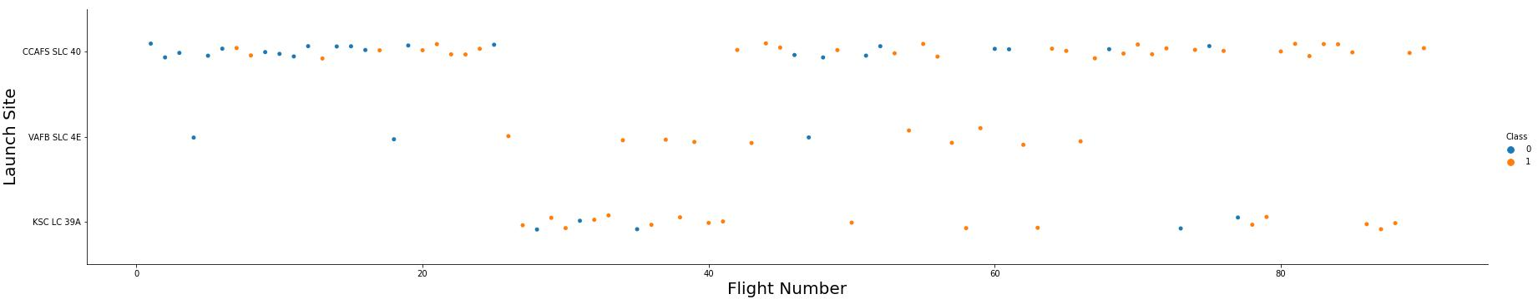
Flight Number vs. Launch Site
At VAFB SLC 4E and KSC LC-39A , the success rate appears to be associated with number of flights.
At CCAFS LC-40, there seems no relationship between flight number and success rate.

Slide 19
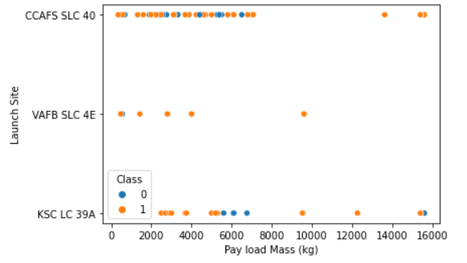
Payload vs. Launch Site
VAFB SLC 4E has nearly 100% success rate when the pay load mass is relatively low.
CCAFS LC-40 has low success rate when pay load mass is low but when the pay load mass is above 10,000 kg, the success rate is 100%.
The overall success rate is high at KSC LC-39A.

Slide 20
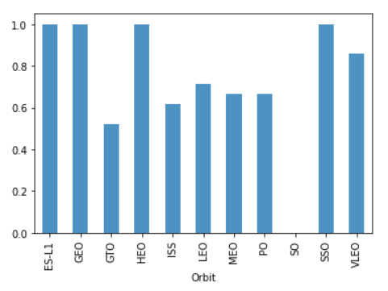
Success Rate vs. Orbit Type
Orbit ES-L1, GEO, HEO and SSO have the highest success rate of 100%.
The GTO has the lowest success rate of lower than 60%.
Other orbits have success rates between 60% and 80%.

Slide 21
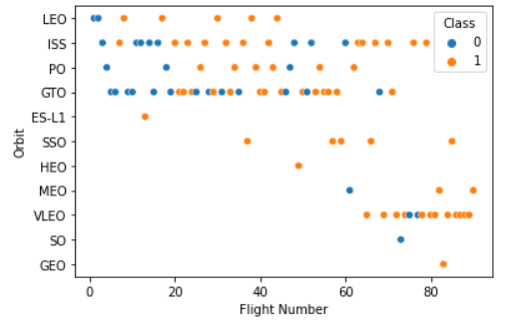
Flight Number vs. Orbit Type
In the LEO orbit the success rate increase with the number of flights.
There seems to be no relationship between flight number when in GTO orbit.

Slide 22
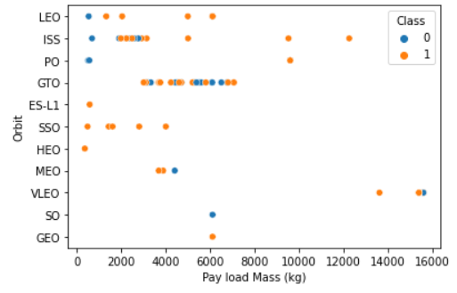
Payload vs. Orbit Type
With heavy payloads the success rate are higher for Polar, LEO and ISS.
For GTO, we cannot distinguish this well as both successful landing and failure landing are both there.

Slide 23
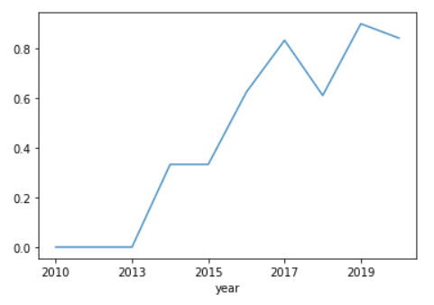
Launch Success Yearly Trend
The launch success rate increases from 2013 to 2020.

Slide 24
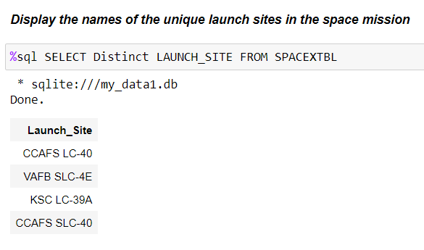
All Launch Site Names
Find the names of the unique launch sites
Four unique launch sites were found as shown in the screenshot.

Slide 25
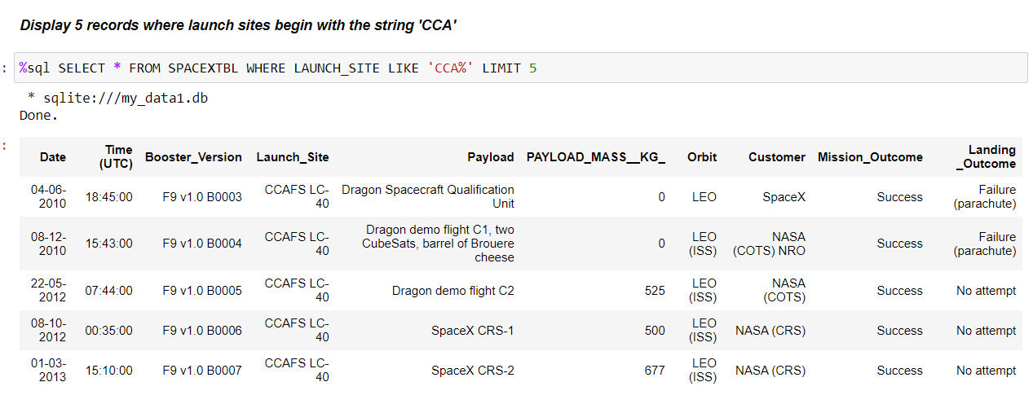
Launch Site Names Begin with 'CCA'
Find 5 records where launch sites begin with `CCA`
The 5 records are shown as follows:

Slide 26
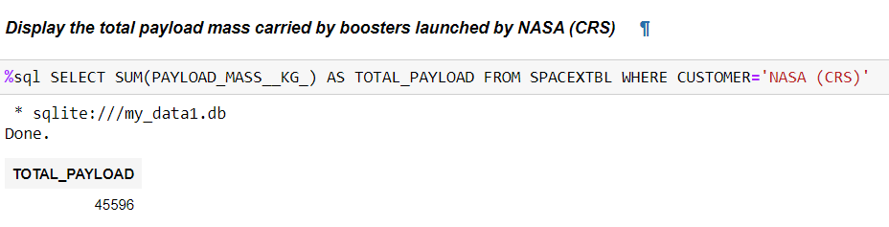
Total Payload Mass
Calculate the total payload carried by boosters from NASA
The total payload mass carried by boosters from NASA is 45596 kg.

Slide 27
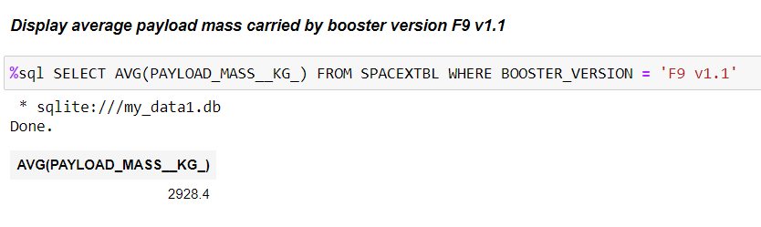
Average Payload Mass by F9 v1.1
Calculate the average payload mass carried by booster version F9 v1.1
The average payload mass carried by booster version F9 v1.1 is 2928.4 kg.

Slide 28
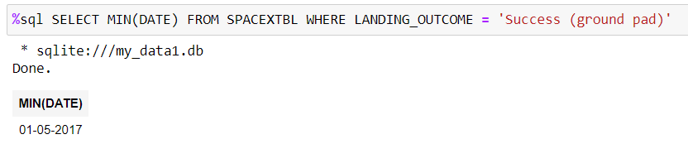
First Successful Ground Landing Date
Find the dates of the first successful landing outcome on ground pad
The earliest date of first successful landing outcome on ground pad is 01-05-2017.

Slide 29
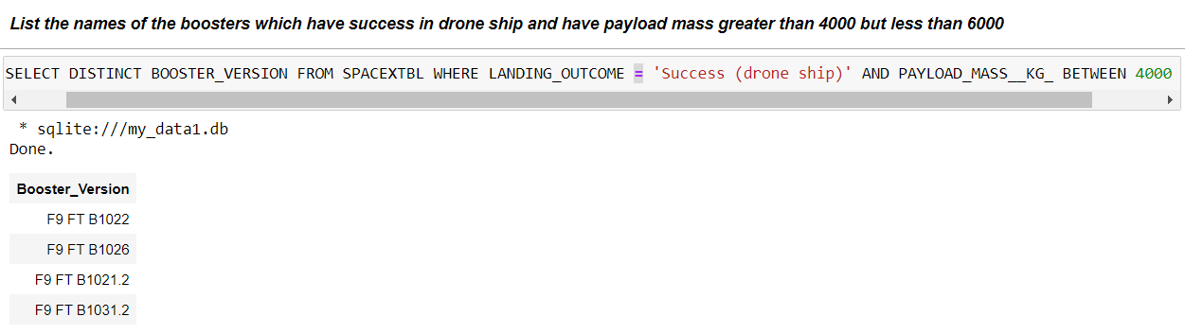
Successful Drone Ship Landing with Payload between 4000 and 6000
List the names of boosters which have successfully landed on drone ship and had payload mass greater than 4000 but less than 6000
Four booster versions were found as shown below.

Slide 30
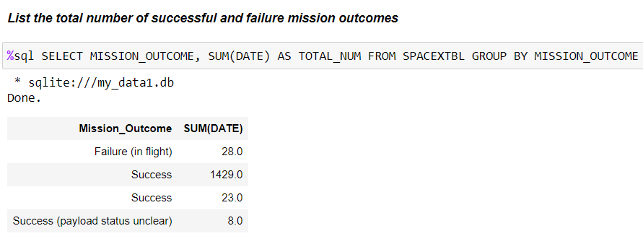
Total Number of Successful and Failure Mission Outcomes
Calculate the total number of successful and failure mission outcomes
Total number of successful mission outcomes is 1460 and the total number of failure mission outcomes is 28.

Slide 31
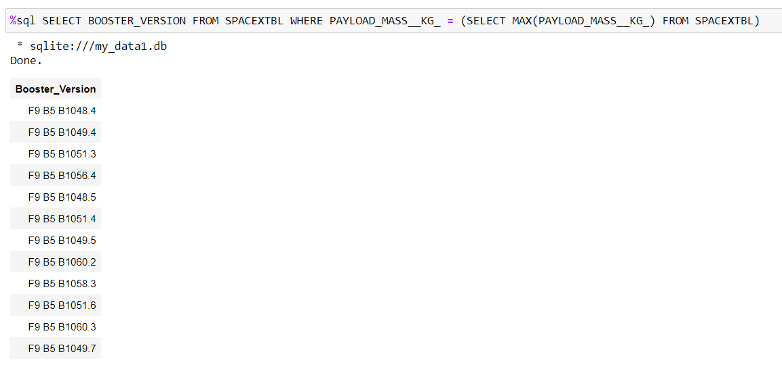
Boosters Carried Maximum Payload
List the names of the booster which have carried the maximum payload mass
12 booster versions were found as shown below.

Slide 32
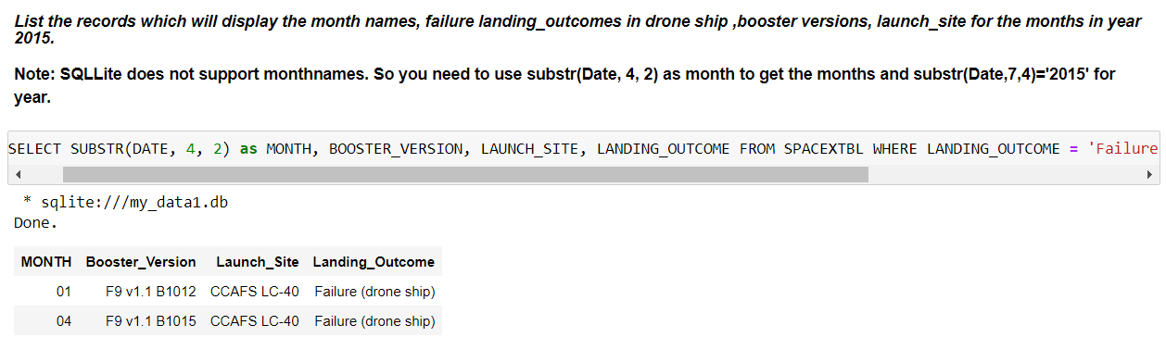
2015 Launch Records
List the failed landing_outcomes in drone ship, their booster versions, and launch site names for in year 2015
There are two failure records, which are in January and April.

Slide 33
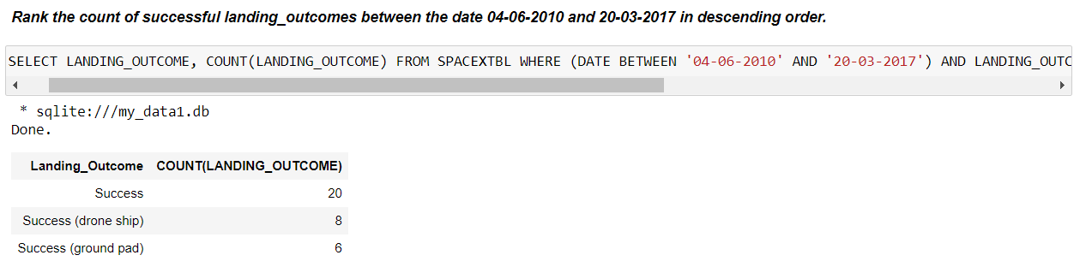
Rank Landing Outcomes Between 2010-06-04 and 2017-03-20
Rank the count of landing outcomes (such as Failure (drone ship) or Success (ground pad)) between the date 2010-06-04 and 2017-03-20, in descending order
Rank of successful landing outcomes is shown below.

Slide 34

Section 3

Slide 35
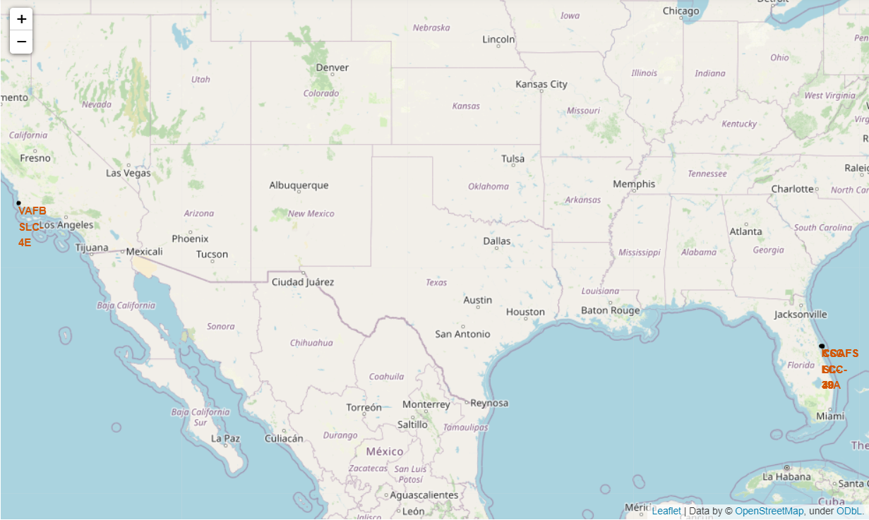
Location of Launch Sites
All launch sites are in proximity to the Equator line.
All launch sites are in very close proximity to the coast.

Slide 36
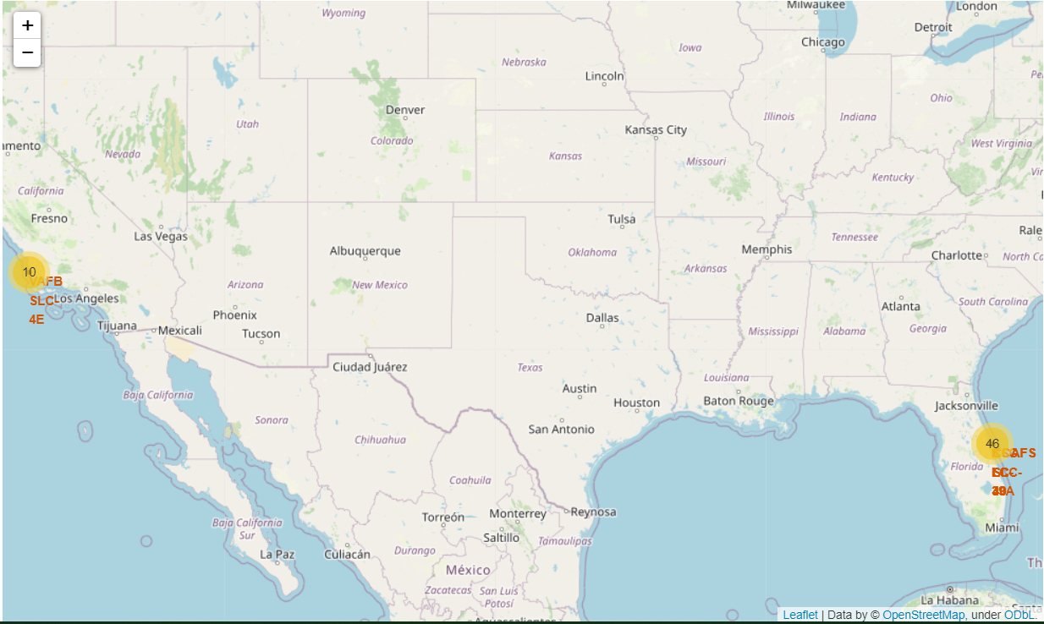
Success/Failed Launches for Each Site

Slide 37
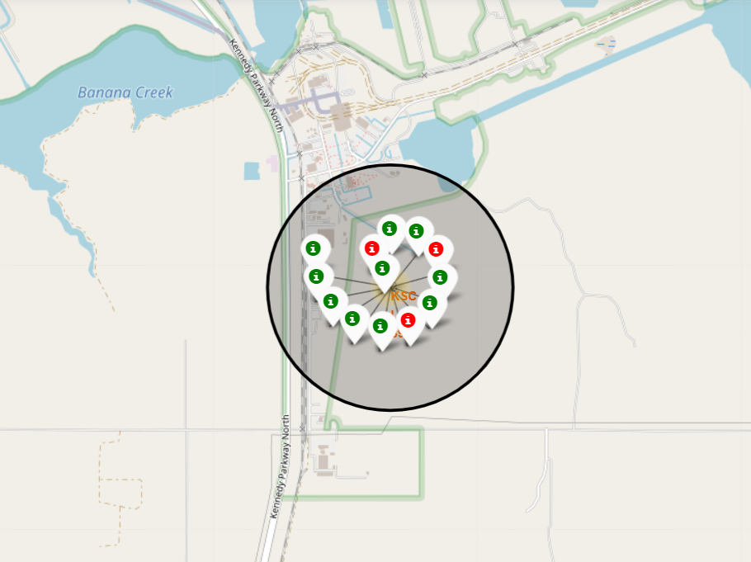
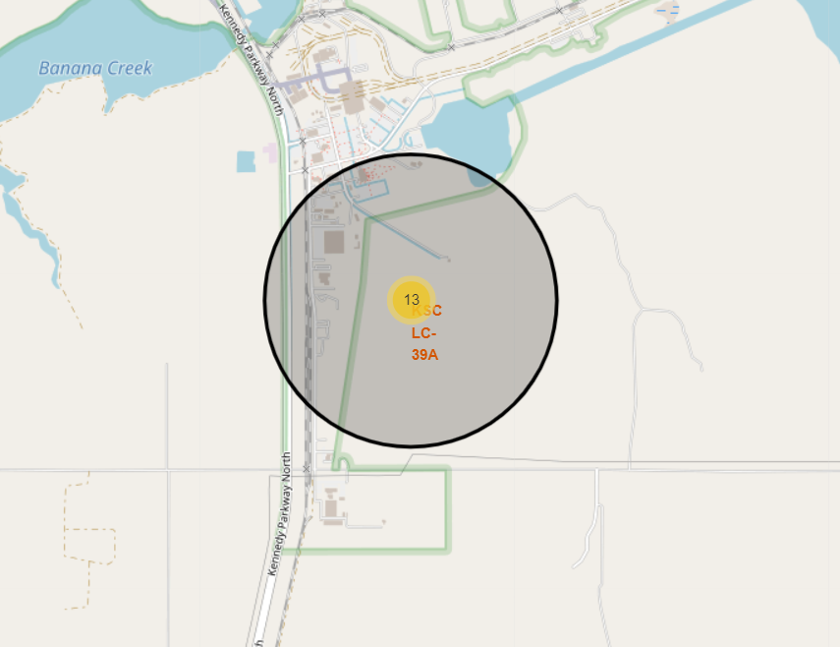
Success/Failed Launches for Each Site
From the color-labeled markers in marker clusters, it is easy to identify that KSC LC-39A has the highest success rate which is about 77%.

Slide 38
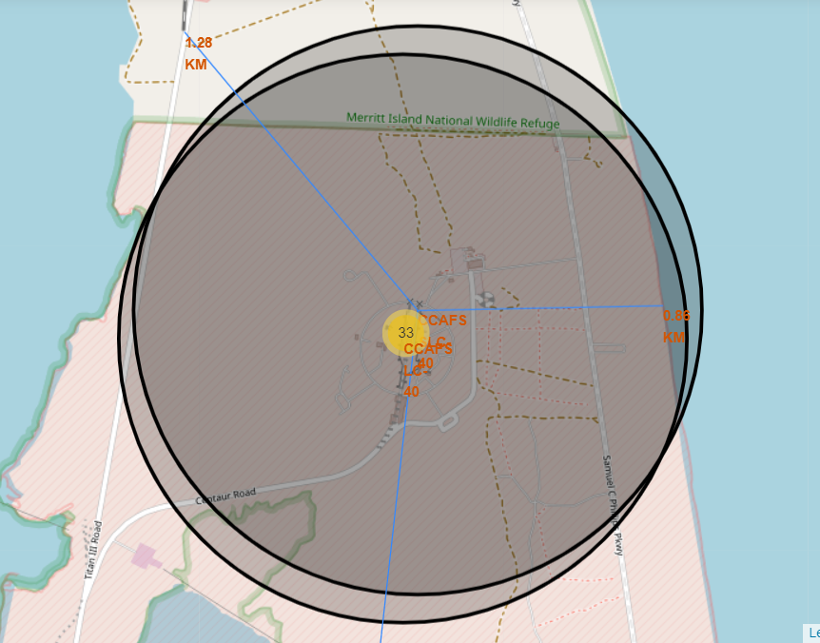
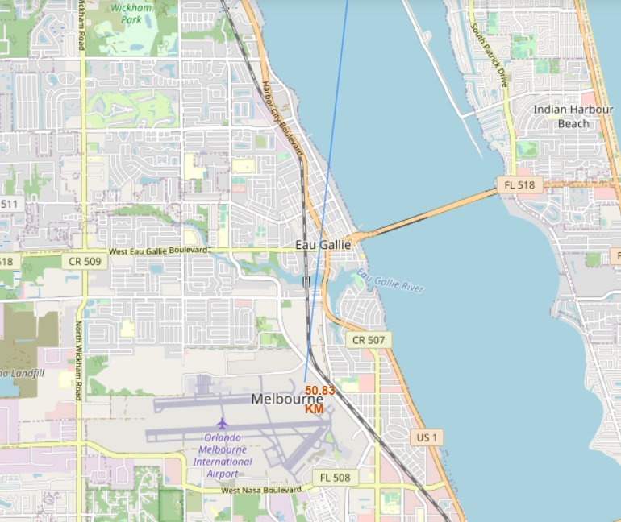
Distances between a Launch Site to its Proximities
CCAFS SLC-40 is in close proximity to the coast and railway but far away from city.

Slide 39

Section 4

Slide 40
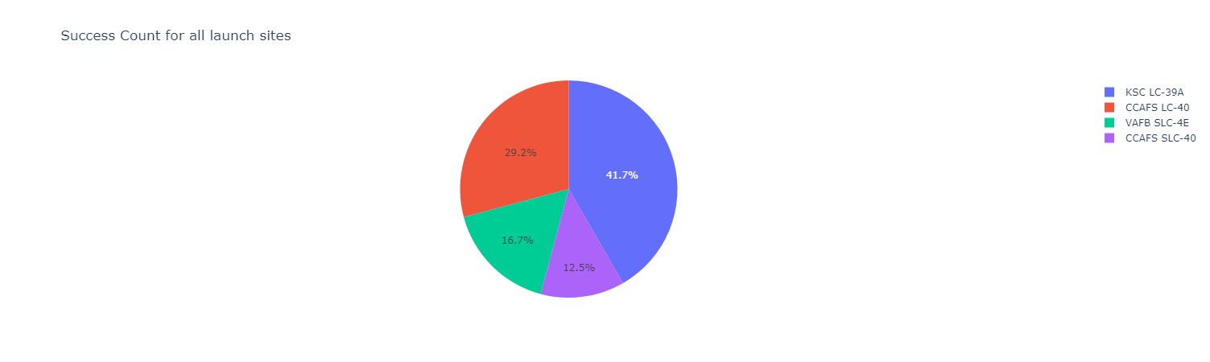
Pie chart of Success Rate for all Launch Sites
42% of all the successful launches are at KSC LC-39A.

Slide 41
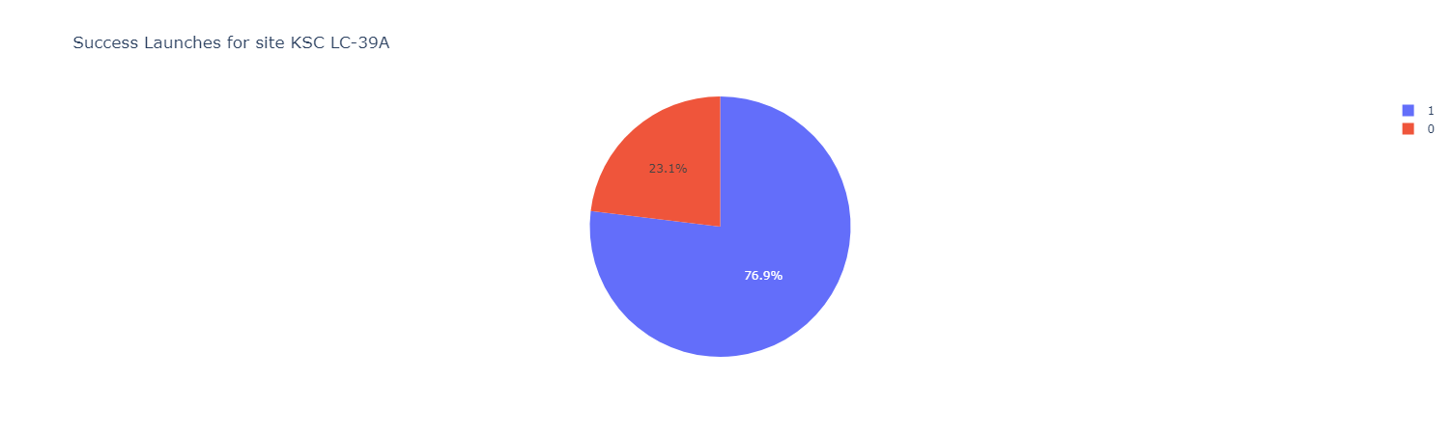
Pie chart for the Launch Site with Highest Success Rate
KSC LC-39A has the highest success rate which is around 77%.

Slide 42
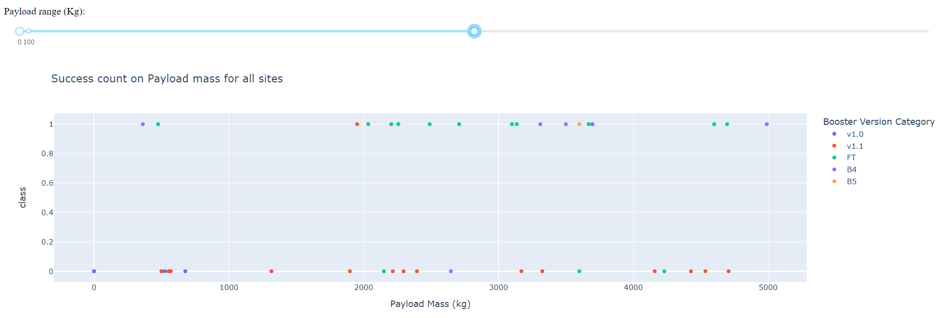
Scatter Plot of Payload vs. Launch Outcome for all Sites
When Palyload Mass is below 5000 kg, booster version of FT has the highest success rate whereas booster version of v1.1 has the lowest success rate.

Slide 43
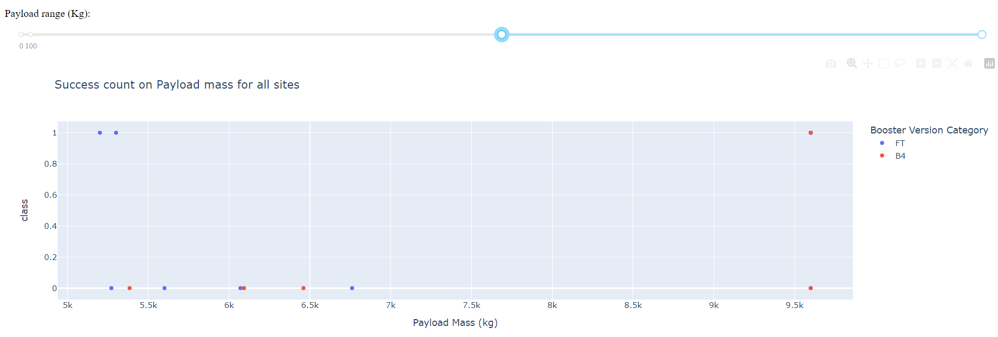
Scatter Plot of Payload vs. Launch Outcome for all Sites
When Palyload Mass is above 5000 kg, only booster version of FT and B4 are applied, and both have relatively low success rate. Success rate of FT is about 33% and success rate of B4 is only 20%.

Slide 44

Section 5

Slide 45
Classification Accuracy
The decision tree has the highest accuracy which is about 94.4%.
Best parameters:
criterion: entropy,
max_depth: 4,
max_features: sqrt,
min_samples_leaf: 2,
min_samples_split: 10,
splitter: best

Slide 46
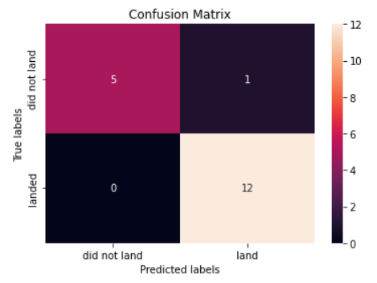
Confusion Matrix
Confusion matrix for the Decision Tree:
For all the 13 successful landings, the decision tree correctly classified 12 times as successful landings.
All the 5 unsuccessful landings are correctly classified by the decision tree.

Slide 47
Conclusions
Location of launch sites are proximity to Equator line, coast and railway but far way from city.
Whether the landing is successful or not are associated with launch site, payload mass, orbit type, boost version, and time.
Launch site KSC LC-39A has the highest success rate which is around 77%.
VAFB SLC 4E has nearly 100% success rate when the pay load mass is relatively low. CCAFS LC-40 has low success rate when pay load mass is low but when the pay load mass is above 10,000 kg, the success rate is 100%.
Orbit ES-L1, GEO, HEO and SSO have the highest success rate of 100%.
When Palyload Mass is below 5000 kg, booster version of FT has the highest success rate whereas booster version of v1.1 has the lowest success rate. When Palyload Mass is above 5000 kg, only booster version of FT and B4 are applied, and both have relatively low success rate.
The launch success rate increases from 2013 to 2020.
The decision tree has the highest classification accuracy which is about 94.4%. Thus, it should be used as the classification method for landing prediction.

Slide 48
Appendix
Table of classification model accuracy comparison using Jaccard Score, F1 Score and LogLoss
Model Type | Jaccard | F1 | LogLoss
K Nearest Neighbors | 0.80 | 0.88 | NA
Decision Tree | 0.92 | 0.96 | NA
SVM | 0.80 | 0.88 | NA
Logistic Regression | 0.80 | 0.88 | 0.48

Slide 49


